Slide 1

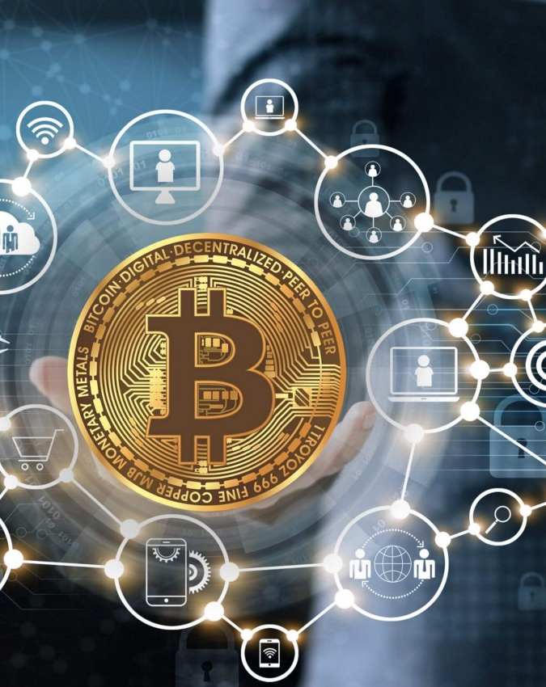
Bitcoin Text Analysis
Class of Program for Big Data Analysis-STU
Final Project
Fall 2021
By Agnes Sithole and Hulnise Jean-François

Slide 2
Summary
Introduction
Exploratory analysis
Text Analysis
Classification
Clustering
Conclusion
Sources

Slide 3

Bitcoin is a decentralized digital currency created in January 2009. Commonly abbreviated as BTC, it is known as a type of cryptocurrency because it uses cryptography to keep it secure. It offers the promise of lower transaction fees than traditional online payment mechanisms do, and unlike government-issued currencies, it is operated by a decentralized authority. There are no physical bitcoins, only balances kept on a public ledger that everyone has transparent access to. Bitcoin is not being recognized legally in most parts of the world, but it is still very popular. Despite its rapid growth and an increasing number of users, bitcoin is considered too volatile and because of its irreversibility, too risky. Our project is about finding what are the sentiments about bitcoins now and see if the people nowadays seem more eager to use it or not.
For that project we used a Twitter Developer API account to collect data from tweeter. We considered the tweets with the words bitcoin and BTC. We did text analysis of the tweets to understand better the position of the people about bitcoins, created classification models and clusters in order to identify if bitcoin have potential of becoming a more largely used currency based on the insight given by the data.

Slide 4
Exploratory Analysis

Slide 5
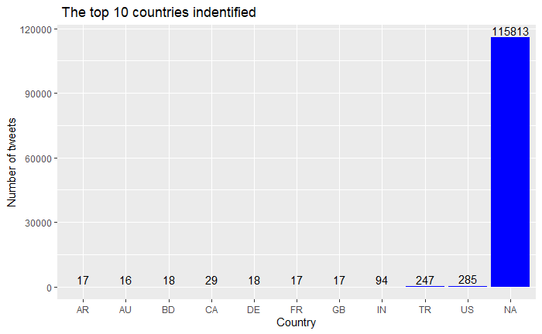
"Most of the countries where the tweeters are located are not identified in the dataset, but we can believe that many countries are represented because we have 67 countries identified.
As we can see in this visualization the top 4 countries identified are : United States, Turkey, India and Canada "

Slide 6
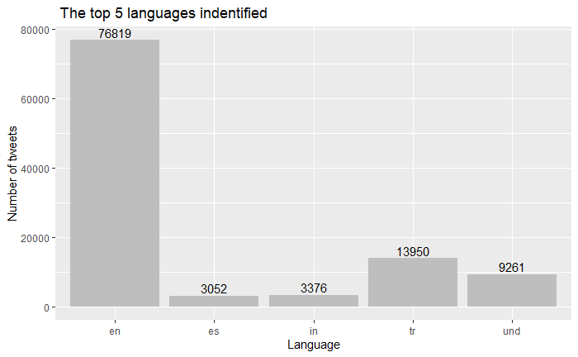
“We have 50 languages represented in the dataset and the top 2 are : English and Turkish“

Slide 7
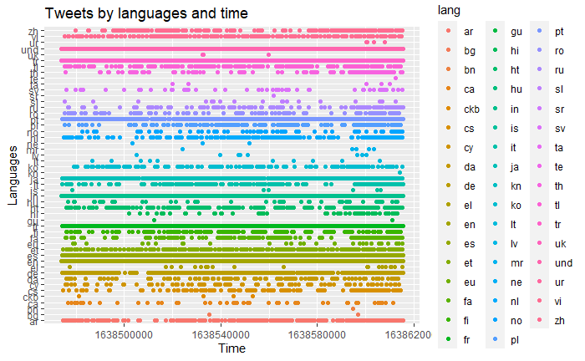

Slide 8
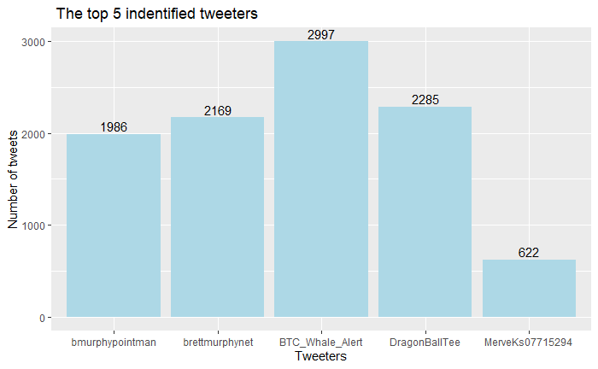
We have 41344 different tweeters, and this visualization shows the top 5.

Slide 9
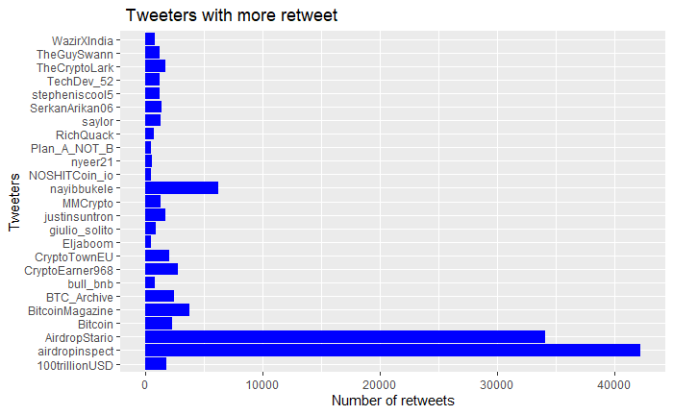
“The 3 tweeters account with more retweets are : airdropinspect , AirdropStario and nayibbukele "

Slide 10
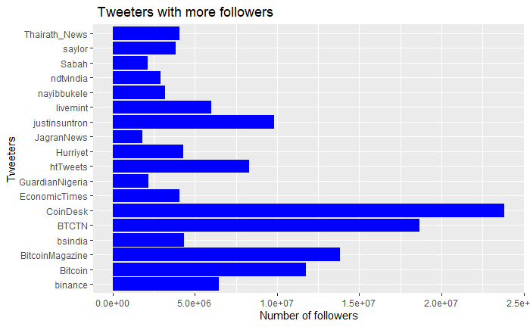
"The top 3 tweeters account with more followers are : CoinDesk, BTCTN and BitcoinMagazine”

Slide 11
Text Analysis

Slide 12
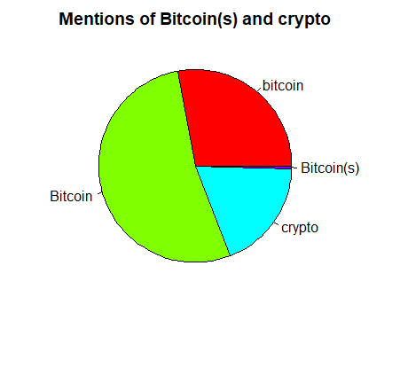
" Number of tweets with 'bitcoin(s)' or Bitcoin(s): 115196.”

Slide 13
Number of hashtags: 116793
Number of mentions: 38081
Giveaway was mentioned 776 times
The top features are :
#bitcoin : 119742
$ : 82392
#btc : 26273
#crypto : 25072
project : 16150
#cryptocurrency : 15329
🚀 : 15255
#eth : 13283
btc : 12236
#Ethereum:11668

Slide 14
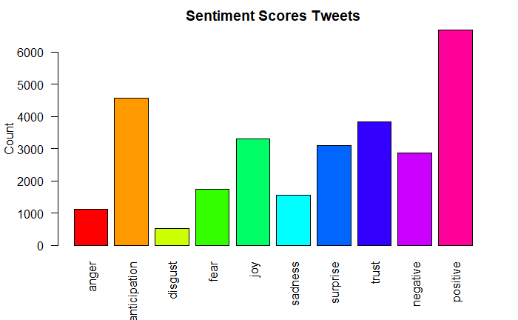
As we can see , there are mostly positive sentiments about bitcoin.

Slide 15
Classification

Slide 16
We found the following accuracy for each model created to predict number of retweets based on those elements of the dataset :created_at, screen_name, display_text_width, retweet_count, lang, protected, followers_count, friends_count , listed_count, statuses_count, favourites_count, account_created_at, verified.
Naive Bayes Classifier Accuracy: 1
LaPlace1 Accuracy: 0.07
LaPlace of 3 Accuracy: 0.06

Slide 17
We found the following accuracy for each model created to predict number of retweets based on those elements of the dataset :retweet_count, protected, followers_count, friends_count , statuses_count, favourites_count, verified.
The accuracy of the Decision tree is : 0.0884

Slide 18
Clustering

Slide 19
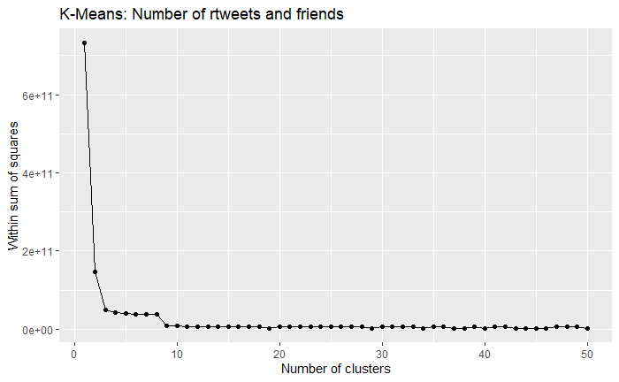
The ideal K is 3 and the ideal k's wss value is : 48633709843

Slide 20
Conclusion
Considering tweets in the dataset, we can say that a little part of the population know about bitcoin. They are also aware of the risks related to it’s use, for example : its volatility and its irreversibility . Nevertheless, we will not forget the advantages of using bitcoin like the low fees and the reduced risk of fraud associated to it. Our data as shown that most of the people aware of it have positive thoughts about it.
As cryptocurrencies and bitcoin are young , it will require time, efforts and awareness too for people to get to know it better. Its use will increase as more individuals get to have information about it to understand how it works and more businesses accept it as payment.

Slide 21
Sources
https://www.investopedia.com/terms/b/bitcoin.asp
https://www.bitcoin.com/

